Slide 1
Loyalty Service Payment Card Integration API
Alexander Adu-Sarkodie
https://www.linkedin.com/in/alexander-adu-sarkodie-063b4b4a/
https://github.com/kukuu?tab=repositories

Slide 2
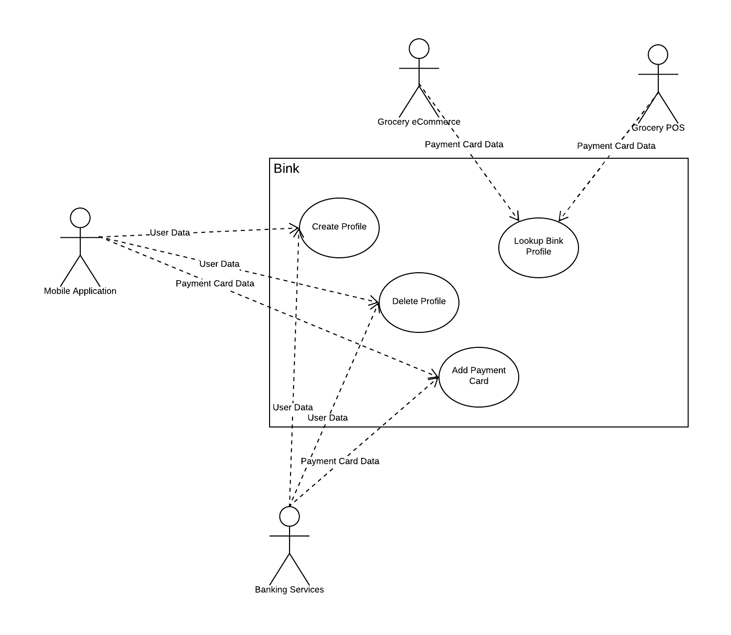
Architecture Use Cases

Slide 3
Integration Loyalty Service & Payment
When designing a Loyalty solution, it is vital to harmonise the needs of the business and its Customers’ expectations. The key is:
Keep it simple.
Remember, one size does not fit all, When it comes to rewarding your Members, There must be an equitable value exchange between what the brand requires of the Customer and what they expect from the brand.
Every voucher has an associated unique code that a customer needs to know in order to redeem the voucher. My example below provides two types of vouchers:
Discount loyalty Vouchers
Gift Loyalty Vouchers
Vouchers can be grouped into campaigns and categories. Depending on strategy, vouchers can be valid only once or multiple times. Marketers and developers can activate vouchers at any time. Voucher's lifetime is either limited or unlimited. Vouchers include a detailed history of their redemptions.

Slide 4
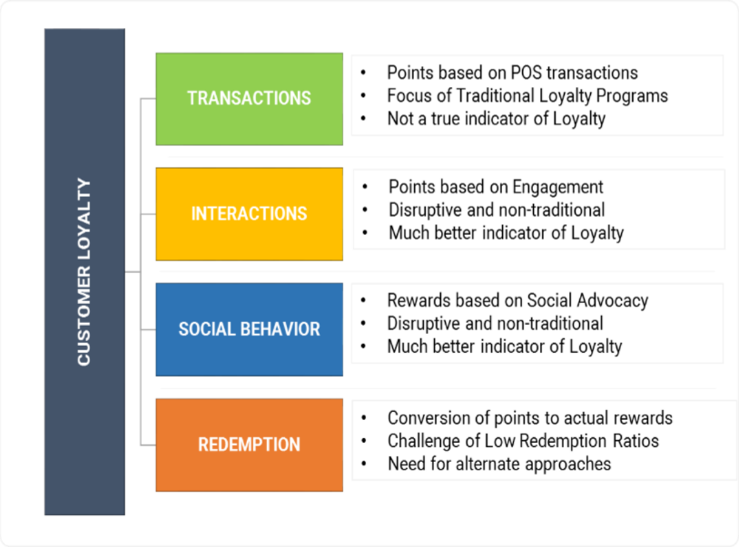

Slide 5
JSON REST API
The Voucher Object
POST - Create Voucher
GET - Get Voucher
PUT - Update Voucher
DELETE - Delete Voucher
GET - List Voucher
POST - Enable Voucher
POST - Disable Voucher
POST - Add Gift Voucher Ballance
POST - Import Vouchers
POST - Import Vouchers by CSV
Validation API
Campaign API
Distributions API
Redemptions API
Customers API
Orders API
Products API
Validation rules
Payment Integration API
API REST calls (JSON) - https://github.com/kukuu/FASTIFY-REST-API/blob/master/loyalty-card-api.md

Slide 6
Integration with cards
The domain model consists of abstract classes that make up the contracts with the external system.
The contracts are defined as abstract classes instead of interfaces to allow the model to be easily extended later if needed. This follows the best practice guidelines defined in the Framework Design Guidelines . Default implementation of the contracts are delivered as part of extensible/maintainable software development design and framework principles- SOLID, ITL/TOGAF Framework. If a provider with an external commerce system contains more functionality than that provided by default, the implementation can be replaced. All instantiation of actual classes will be handled through dependency injection.
Class types:
PaymentMethod - The PaymentMethod class is responsible for representing a type of payment option, for example, Visa is a type of PayCard option.
PaymentOption - The PaymentOption class is responsible for representing different payment option types, for example,Visa.
PaymentOptionType - The PaymentOptionType class is a virtual enum class responsible for representing known payment option types, for example, gift card, credit card, and so on.
PaymentLookup - The PaymentLookup class is used to hold the information required to lookup payment prices for a collection of line items.
PaymentPrice - The PaymentPrice class inherits from the Price object and is used to hold the pricing information for a payment option, method, and list of line items.
CardType - The CardType class is a virtual enum class responsible for representing the type of payment cards that can be accepted when processing a payment.
PurchaseLevel - The PurchaseLevel class is a virtual enum class that represents the level of card processing that will be performed during a payment service transaction.
TransactionType - The TransactionType class is a virtual enum class that represents the type of transaction being performed with a payment service.

Slide 7
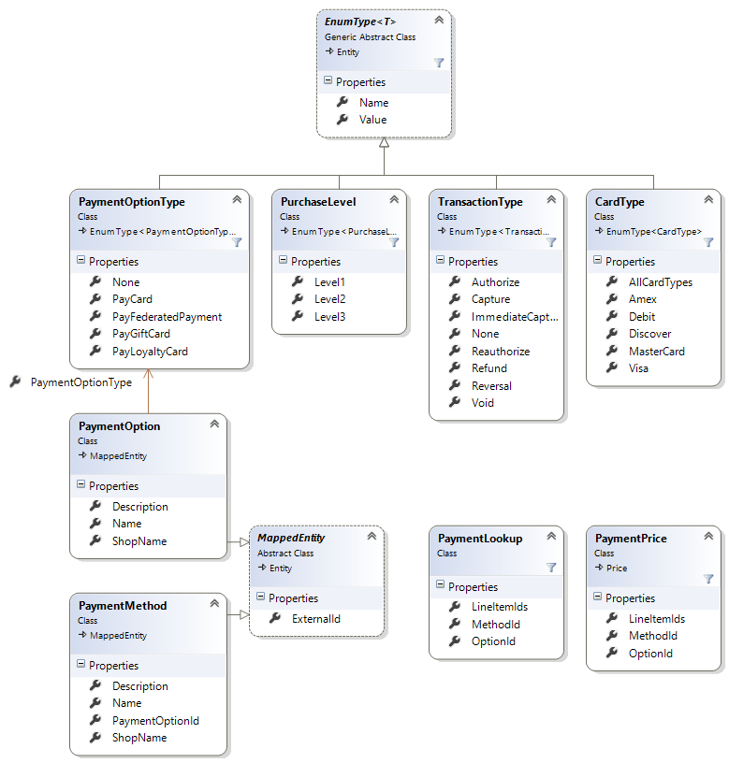
Payment domain model

Slide 8
Payment method Classes,Types & Lookup
Payment Method Class - https://github.com/kukuu/FASTIFY-REST-API/blob/master/payment-domain-model/payment-domain-model-1.png
Payment Option Class - https://github.com/kukuu/FASTIFY-REST-API/blob/master/payment-domain-model/payment-domain-model-2.png
Payment Option Type - https://github.com/kukuu/FASTIFY-REST-API/blob/master/payment-domain-model/payment-domain-model-3.png
Payment Lookup - https://github.com/kukuu/FASTIFY-REST-API/blob/master/payment-domain-model/payment-domain-model-4.png
Payment Price - https://github.com/kukuu/FASTIFY-REST-API/blob/master/payment-domain-model/payment-domain-model-5.png
Card Type - https://github.com/kukuu/FASTIFY-REST-API/blob/master/payment-domain-model/payment-domain-model-6.png
Transaction Type - https://github.com/kukuu/FASTIFY-REST-API/blob/master/payment-domain-model/payment-domain-model-7.png
Brand Purchase Levels - https://github.com/kukuu/FASTIFY-REST-API/blob/master/payment-domain-model/payment-domain-purchase-level-8.png
Transactions Type - https://github.com/kukuu/FASTIFY-REST-API/blob/master/payment-domain-model/payment-domain0transaction-type-9.png

Slide 9
Hosting - Provisioning 99% Service Availability
To ensure 99% availability of the service, AWS is best placed to provide a platform that is ideally suited for building highly available systems that is fault tolerant, affordable, reliable and can operate with minimum amount of human interaction.
Best design practices to ensure the fulfilment of the availability are:
Support and design for failure
Ensure presence of Multiple Availability Zones to support failures, and not limited to various forms of natural disasters.
Provisioning of horizontal Scaling. Using instances that are configured to provide Self Healing through use of Amazon Cloud Watch.
Loose coupling - Implementing Distributed Systems (Microservices)
Additionally, I would recommend NGIX Plus as ELB for simple reasons of providing extended performance for handling session persistence, and Self Healing (Health Checks and Auto Scaling) through API configuration management. It also provide CPU monitoring services using Syslog.
AWS Physical architectural implementation
Designing for failure : Elastic IP - https://github.com/kukuu/FASTIFY-REST-API/blob/master/payment-domain-model/provisioning-99percent-availability/1-design-for-failure-elasticIP.png
Single EC2 instance - https://github.com/kukuu/FASTIFY-REST-API/blob/master/payment-domain-model/provisioning-99percent-availability/2-design-for-failure-ELB.png
Multiple EC2 instance - https://github.com/kukuu/FASTIFY-REST-API/blob/master/payment-domain-model/provisioning-99percent-availability/3-design-for-failure-multiple-ec2-i.png
Activating Auto Watch Policy - https://github.com/kukuu/FASTIFY-REST-API/blob/master/payment-domain-model/provisioning-99percent-availability/4-auto-scaling-cloud-watch-policy.png
Automatic CPU usage detection - https://github.com/kukuu/FASTIFY-REST-API/blob/master/payment-domain-model/provisioning-99percent-availability/5-auto-scaling-CPU-detection-kicks-in.png
Additional instances triggered and added automatically - https://github.com/kukuu/FASTIFY-REST-API/blob/master/payment-domain-model/provisioning-99percent-availability/6-auto-scaling-additional-i-kicks-in.png

Slide 10
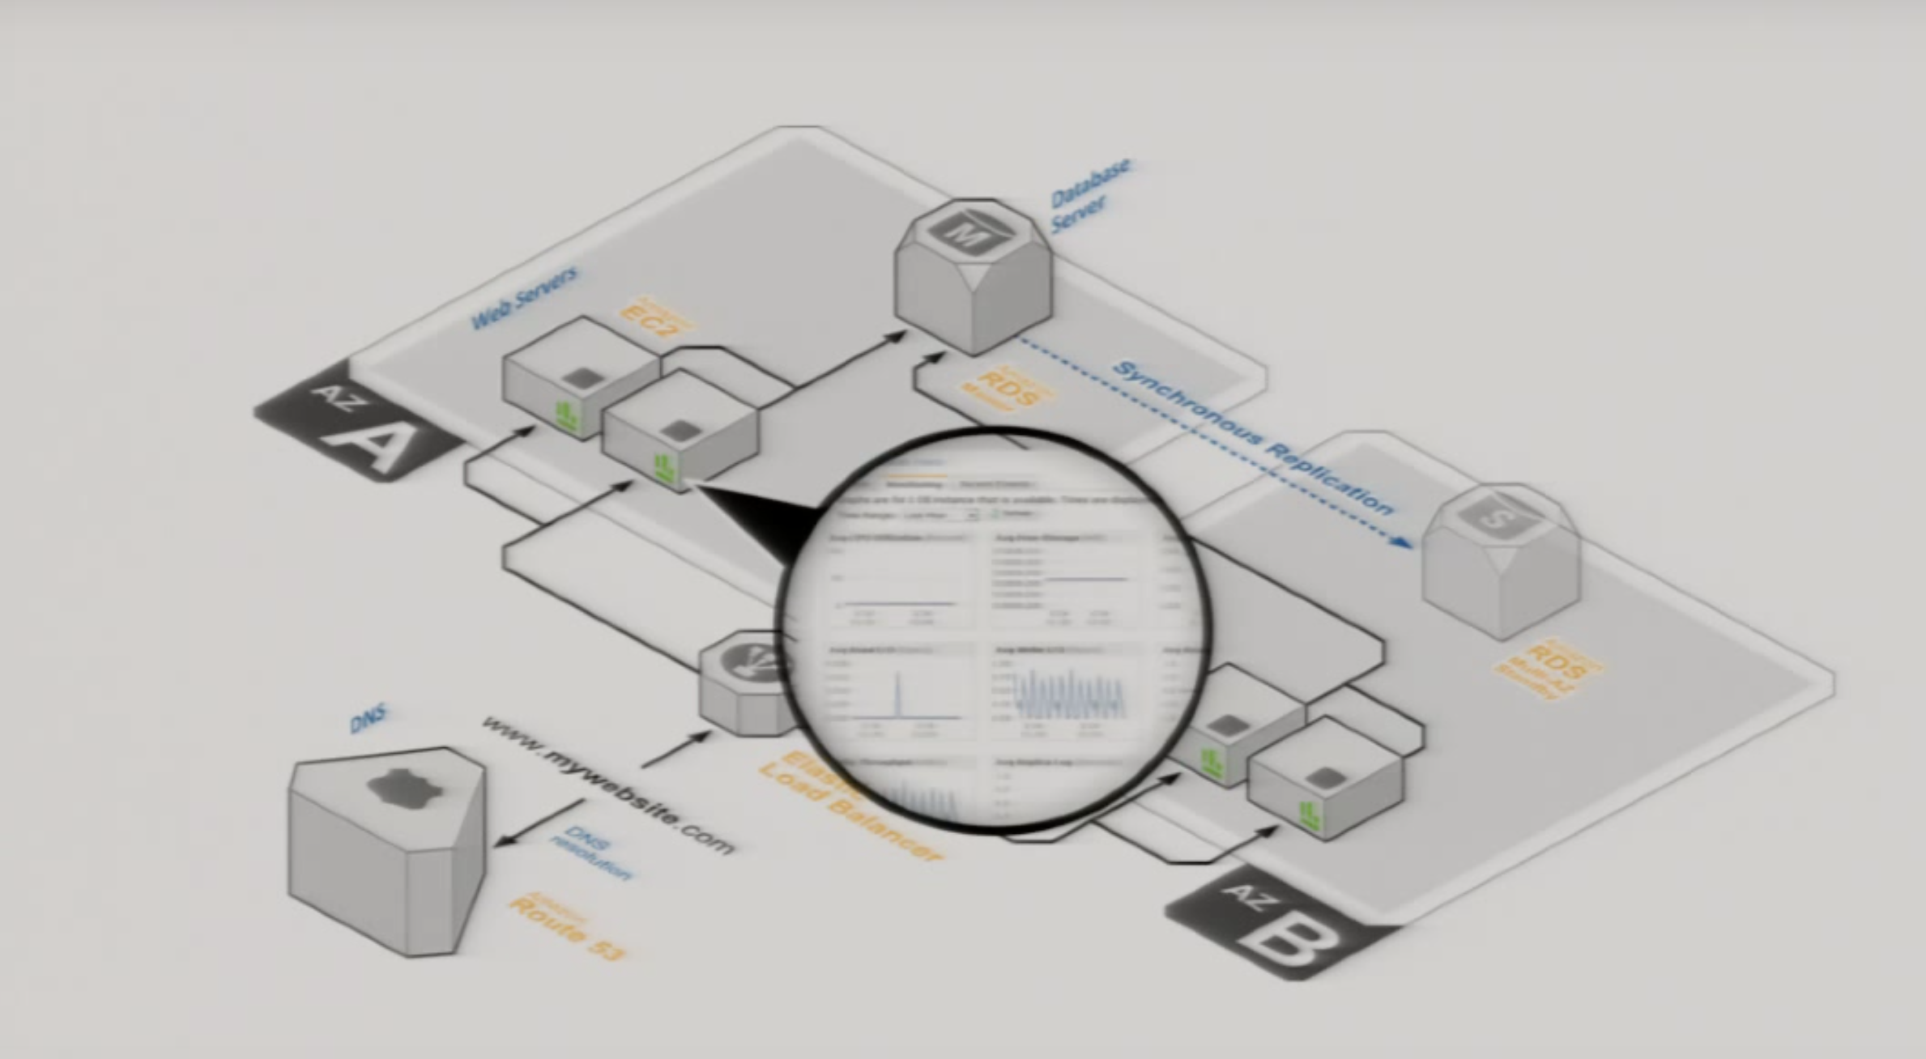
Auto-scaling with cloud Watch
Activating Auto Watch Policy

Slide 11
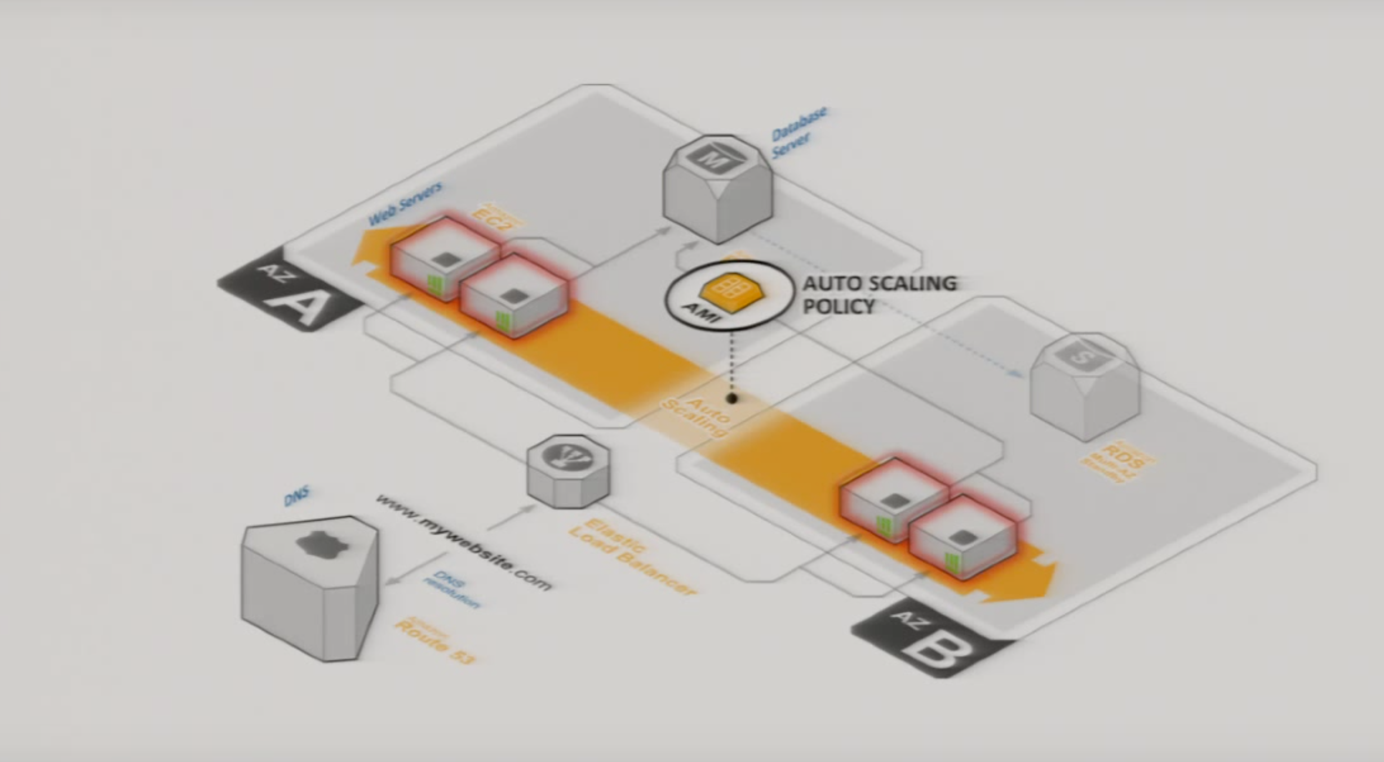
Auto-scaling with cloud Watch
CPU usage detection - Policy ready to kick in

Slide 12
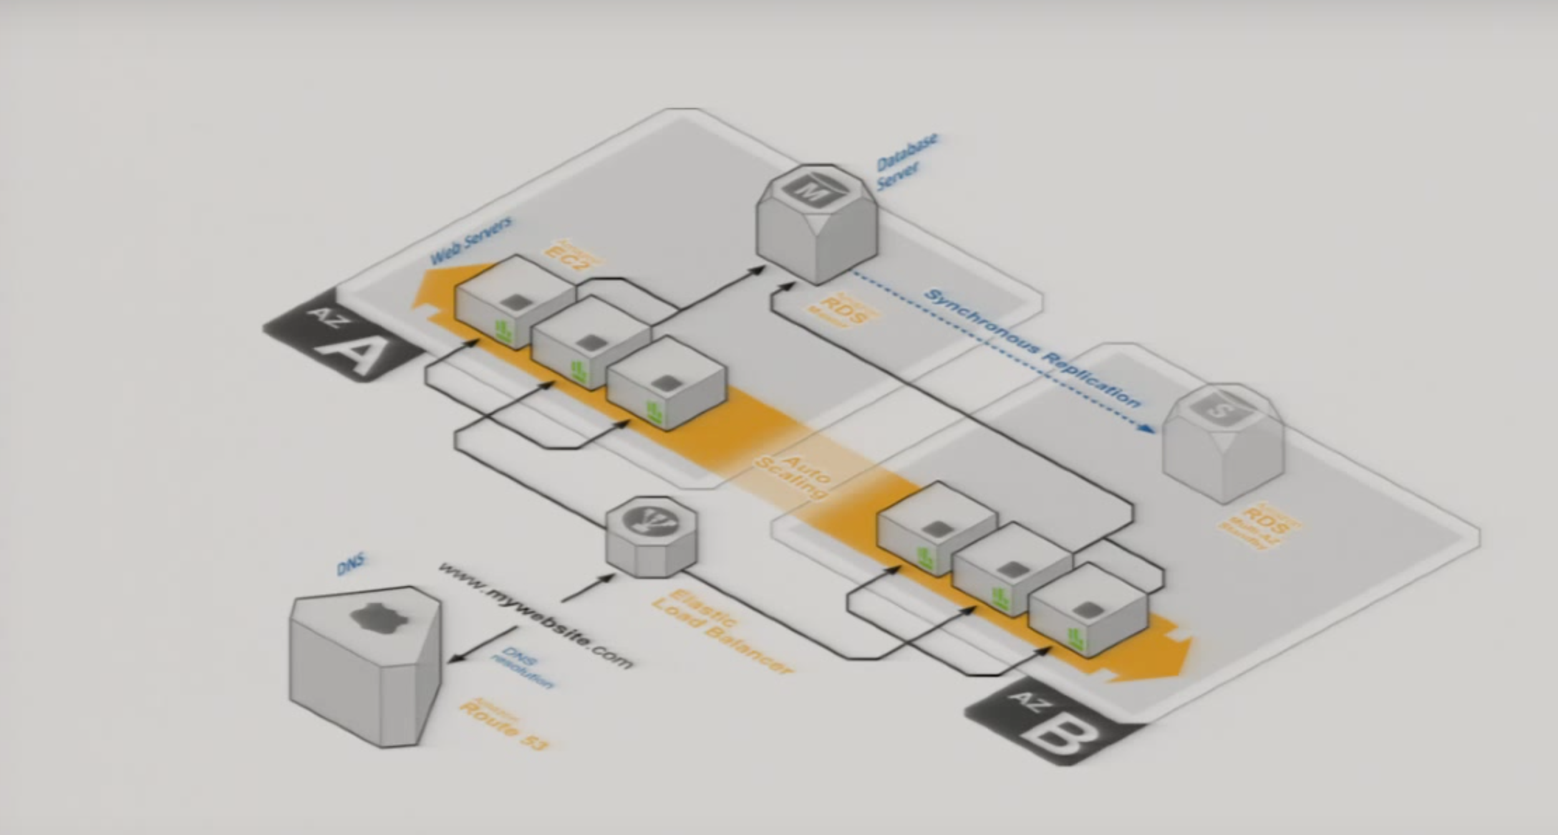
Auto-scaling with cloud Watch
Additional instances added automatically

Slide 13
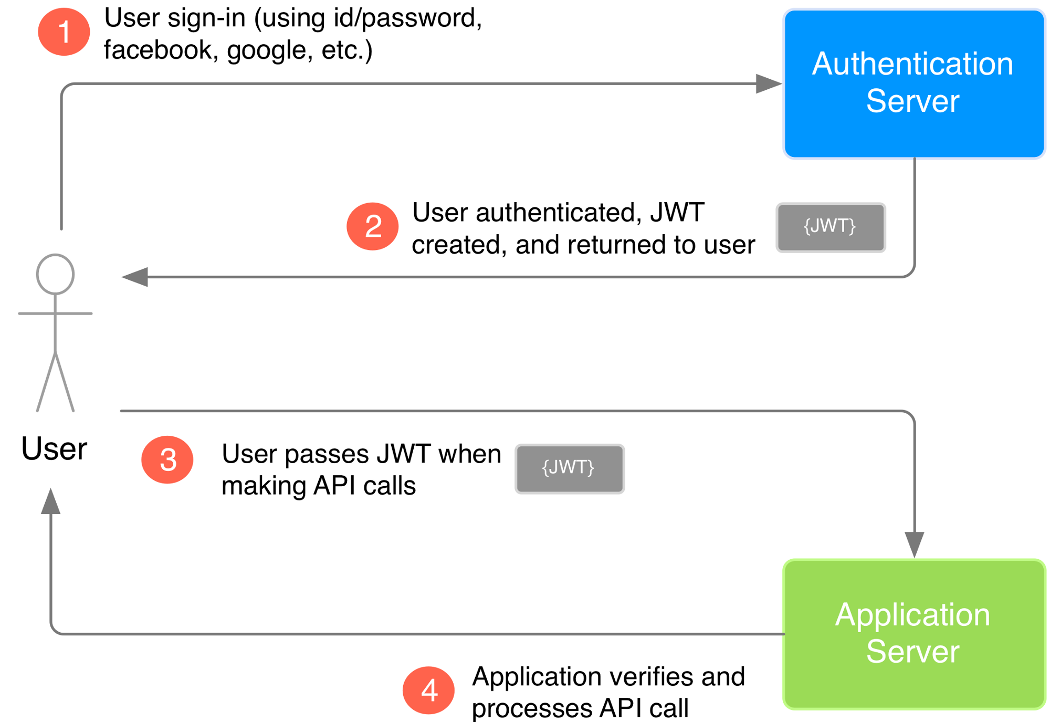
Attaching JWT to API requests/response
JSON Web Token

Slide 14
PCI DSS Compliance
Compliance
Adherence to PCI DSS set of rules and regulations are vital to the the successful operations of the Loyalty Scheme, Card integration process. Failures can result in heavy fines and ultimate termination of businesses with card payment brands.
The following areas are identified for monitoring:
Build and maintain secure encryption of network layer. With right certificates and policies (CA, SSL and TLS) - Appropriate use of Client and Server Digital Certificates.
Blockchain - storing data across its network, the blockchain eliminates the risks that come with data being held centrally.
Secure encryption of customer data - Public and Private Keys.
Secure validation of code at client level, and API (JWT, OAuth)
Managing security in code vulnerabilities using DevSecOps. Having policies in place to detect and uphold thresholds SNYk is a useful security policy plugin. Monitors Unit test coverage in CI/CD pipeline during build process from GitHub. Stopping delivery of software to hosting environment.
Conforming to GDPR sets of regulations
Use of iFRAMES to to hide and transport sensitive data between servers to avoid visibility.
2FA
Authenticate user with JSON Web Token -
PCI DSS AWS Architecture - https://github.com/kukuu/FASTIFY-REST-API/tree/master/payment-domain-model/PCI-DSS-Architecture

